Slide 1
What is Data Science?
A rather brief introduction to

Slide 2
Ahmad Zaky Syihan
Hi, my name is

Slide 3
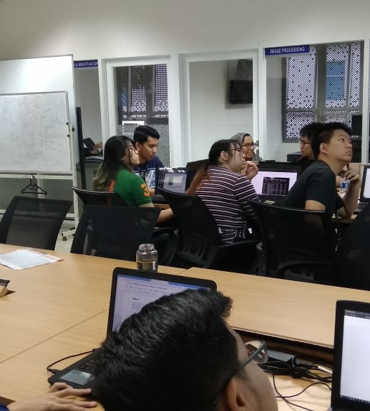
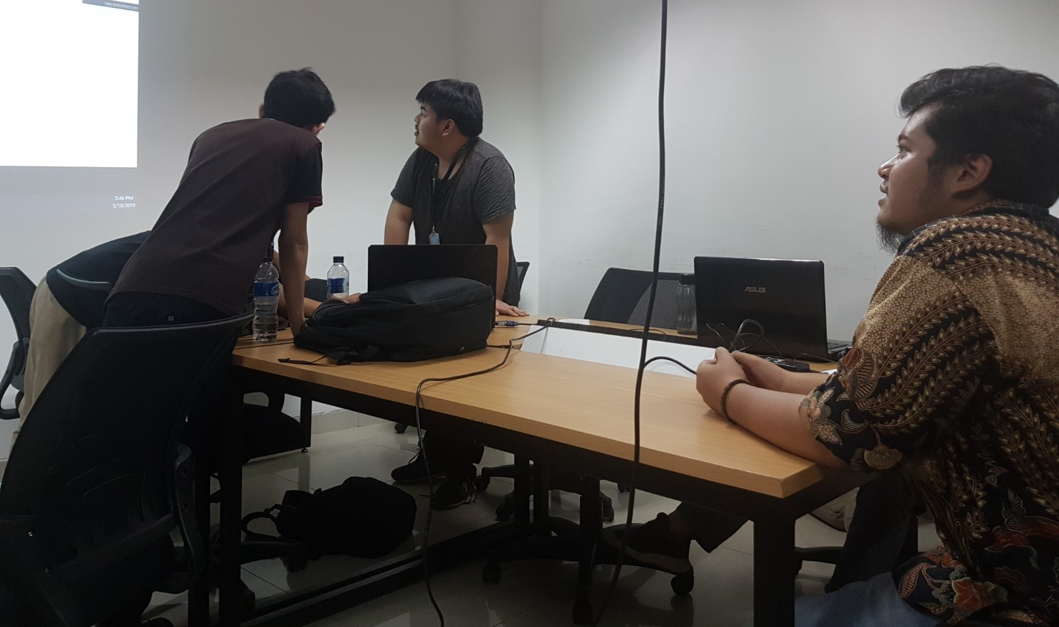
UMN Artificial Intelligence Lab Instructor

Slide 4
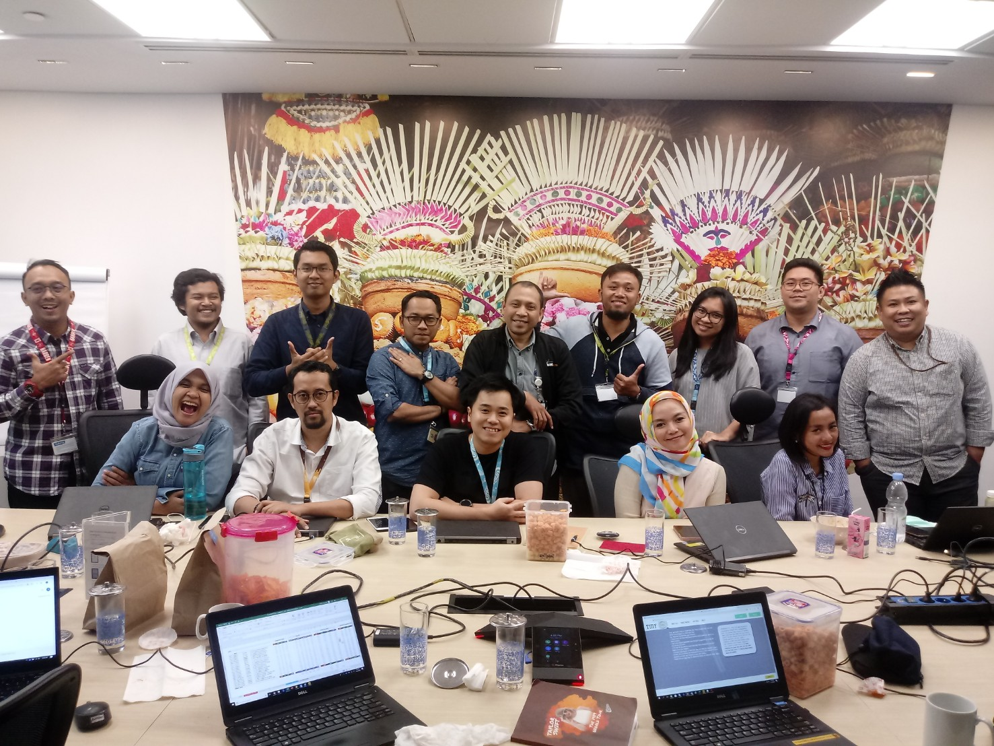
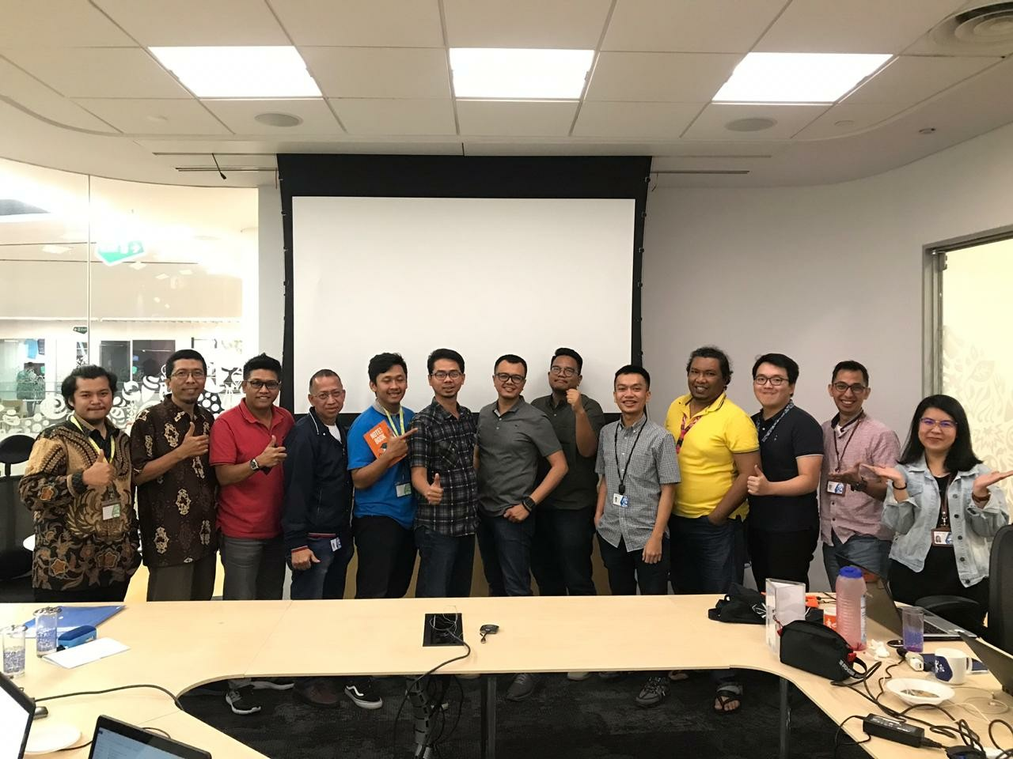
Unilever Power BI Training Instructor

Slide 5
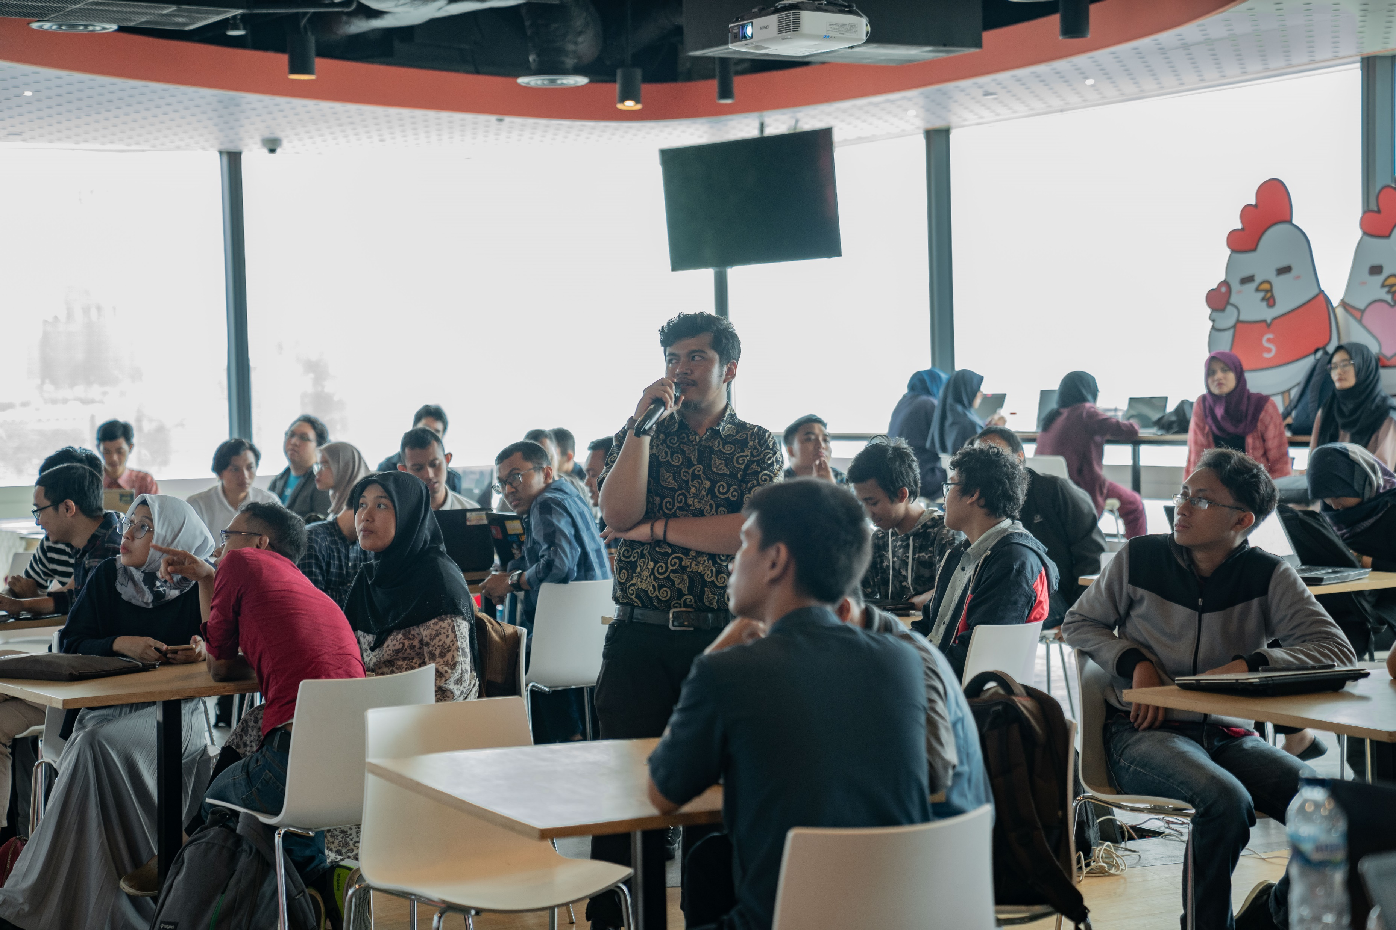
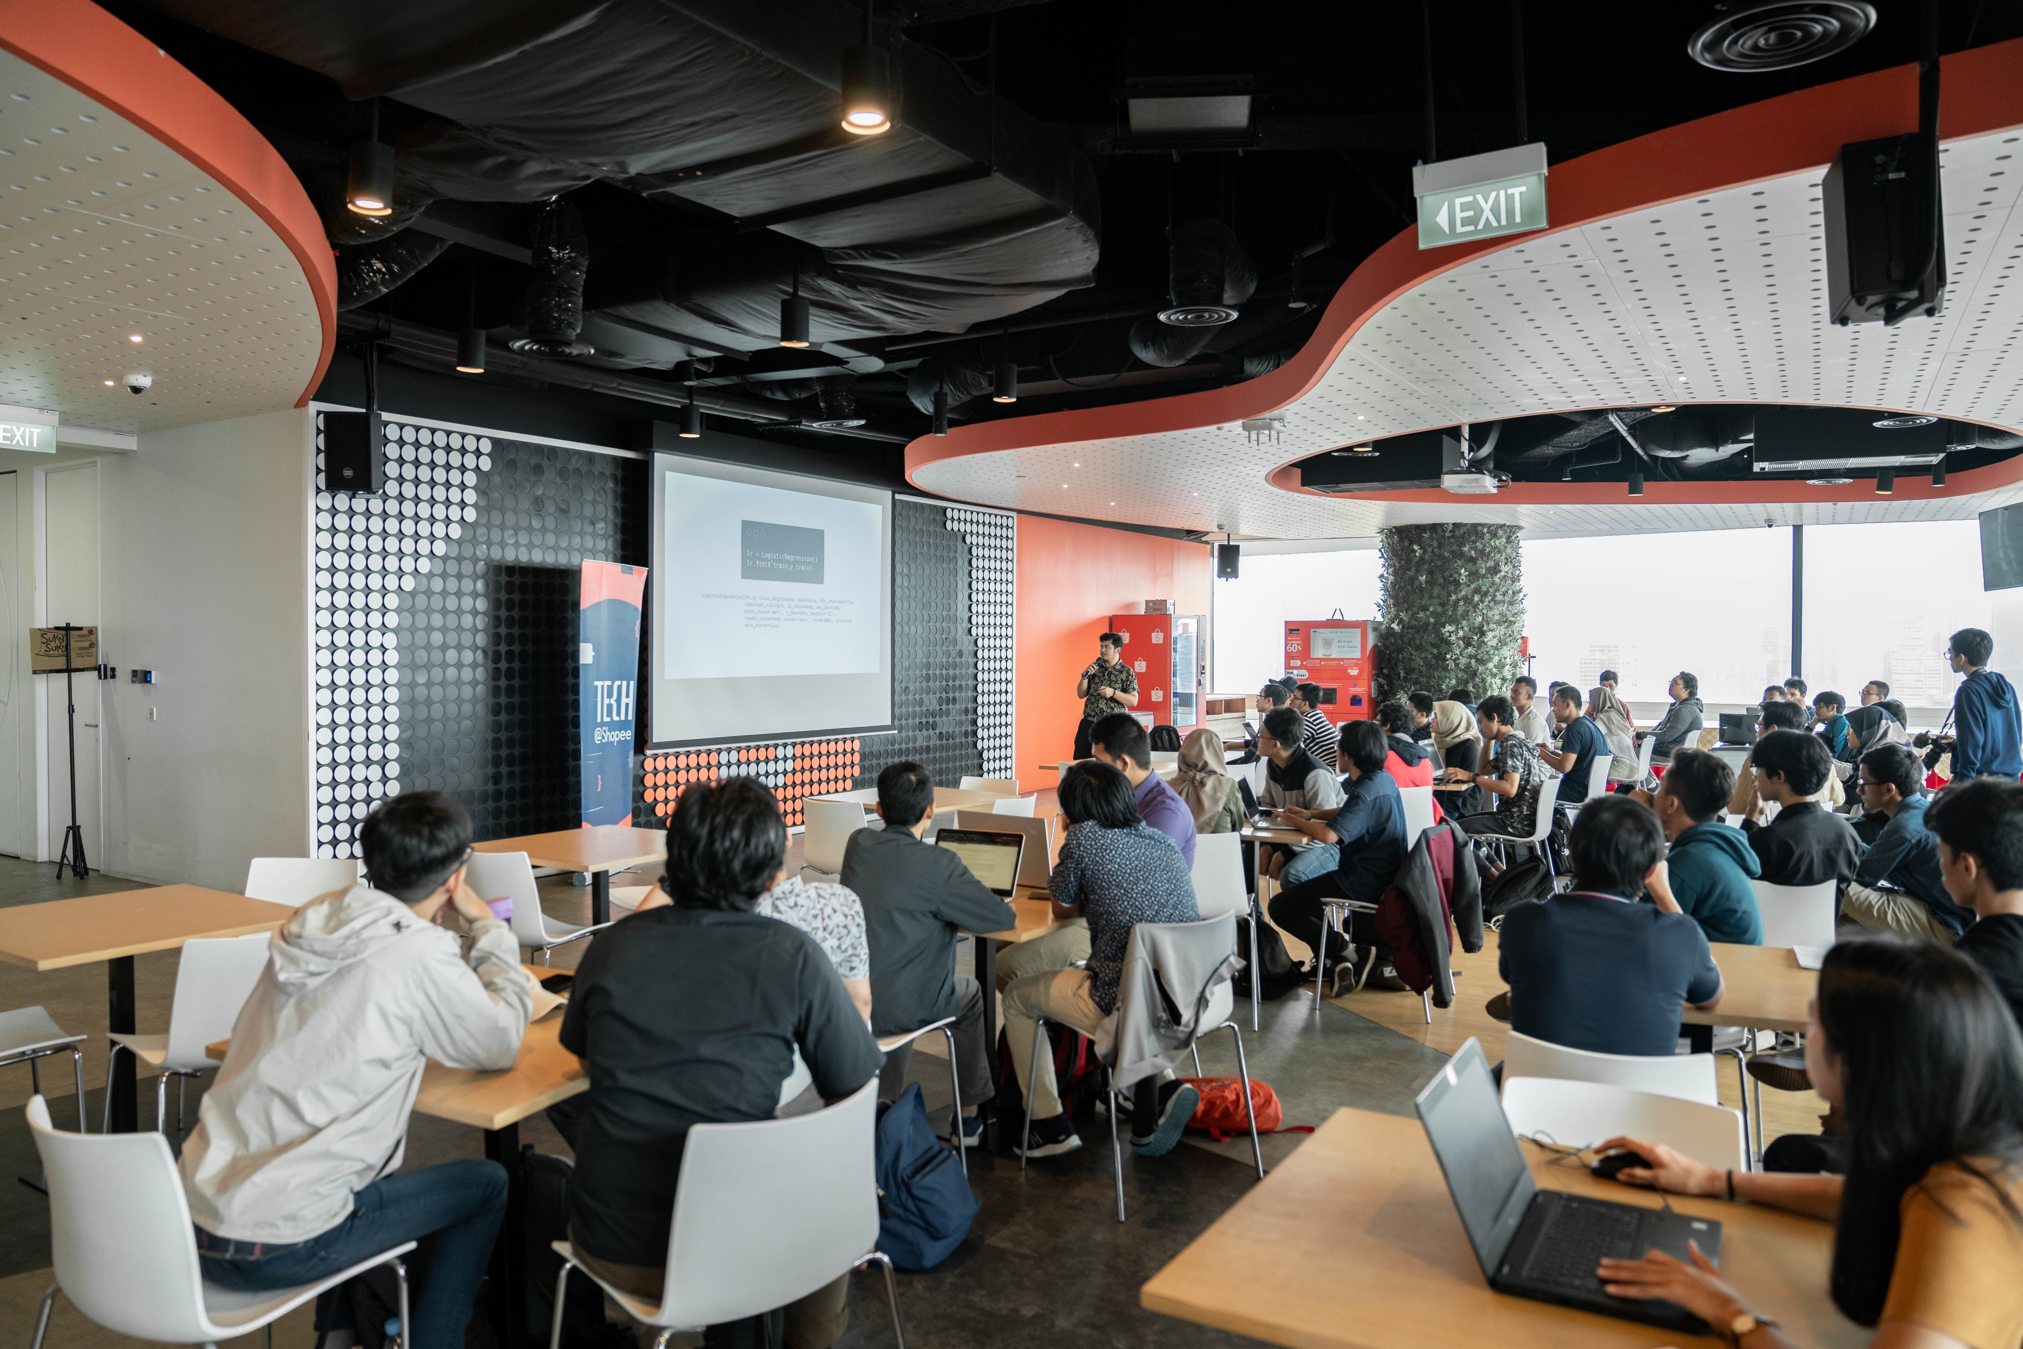
Shopee National Data Science Competition

Slide 6


Slide 7
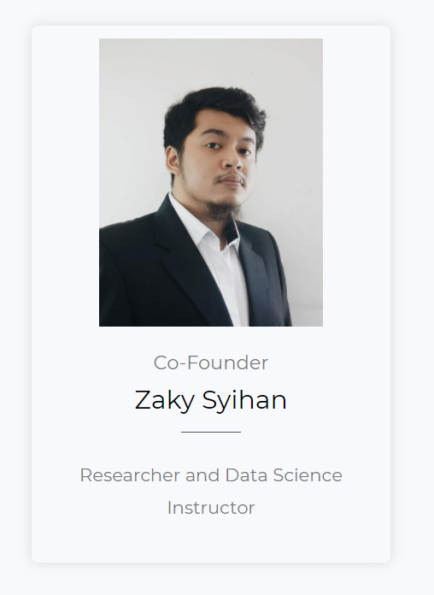

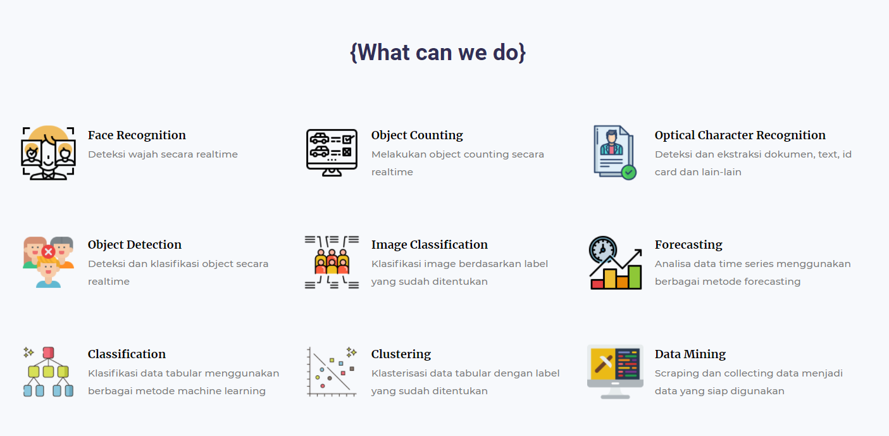

Slide 8
What is Data Science?
A rather brief introduction to

Slide 9
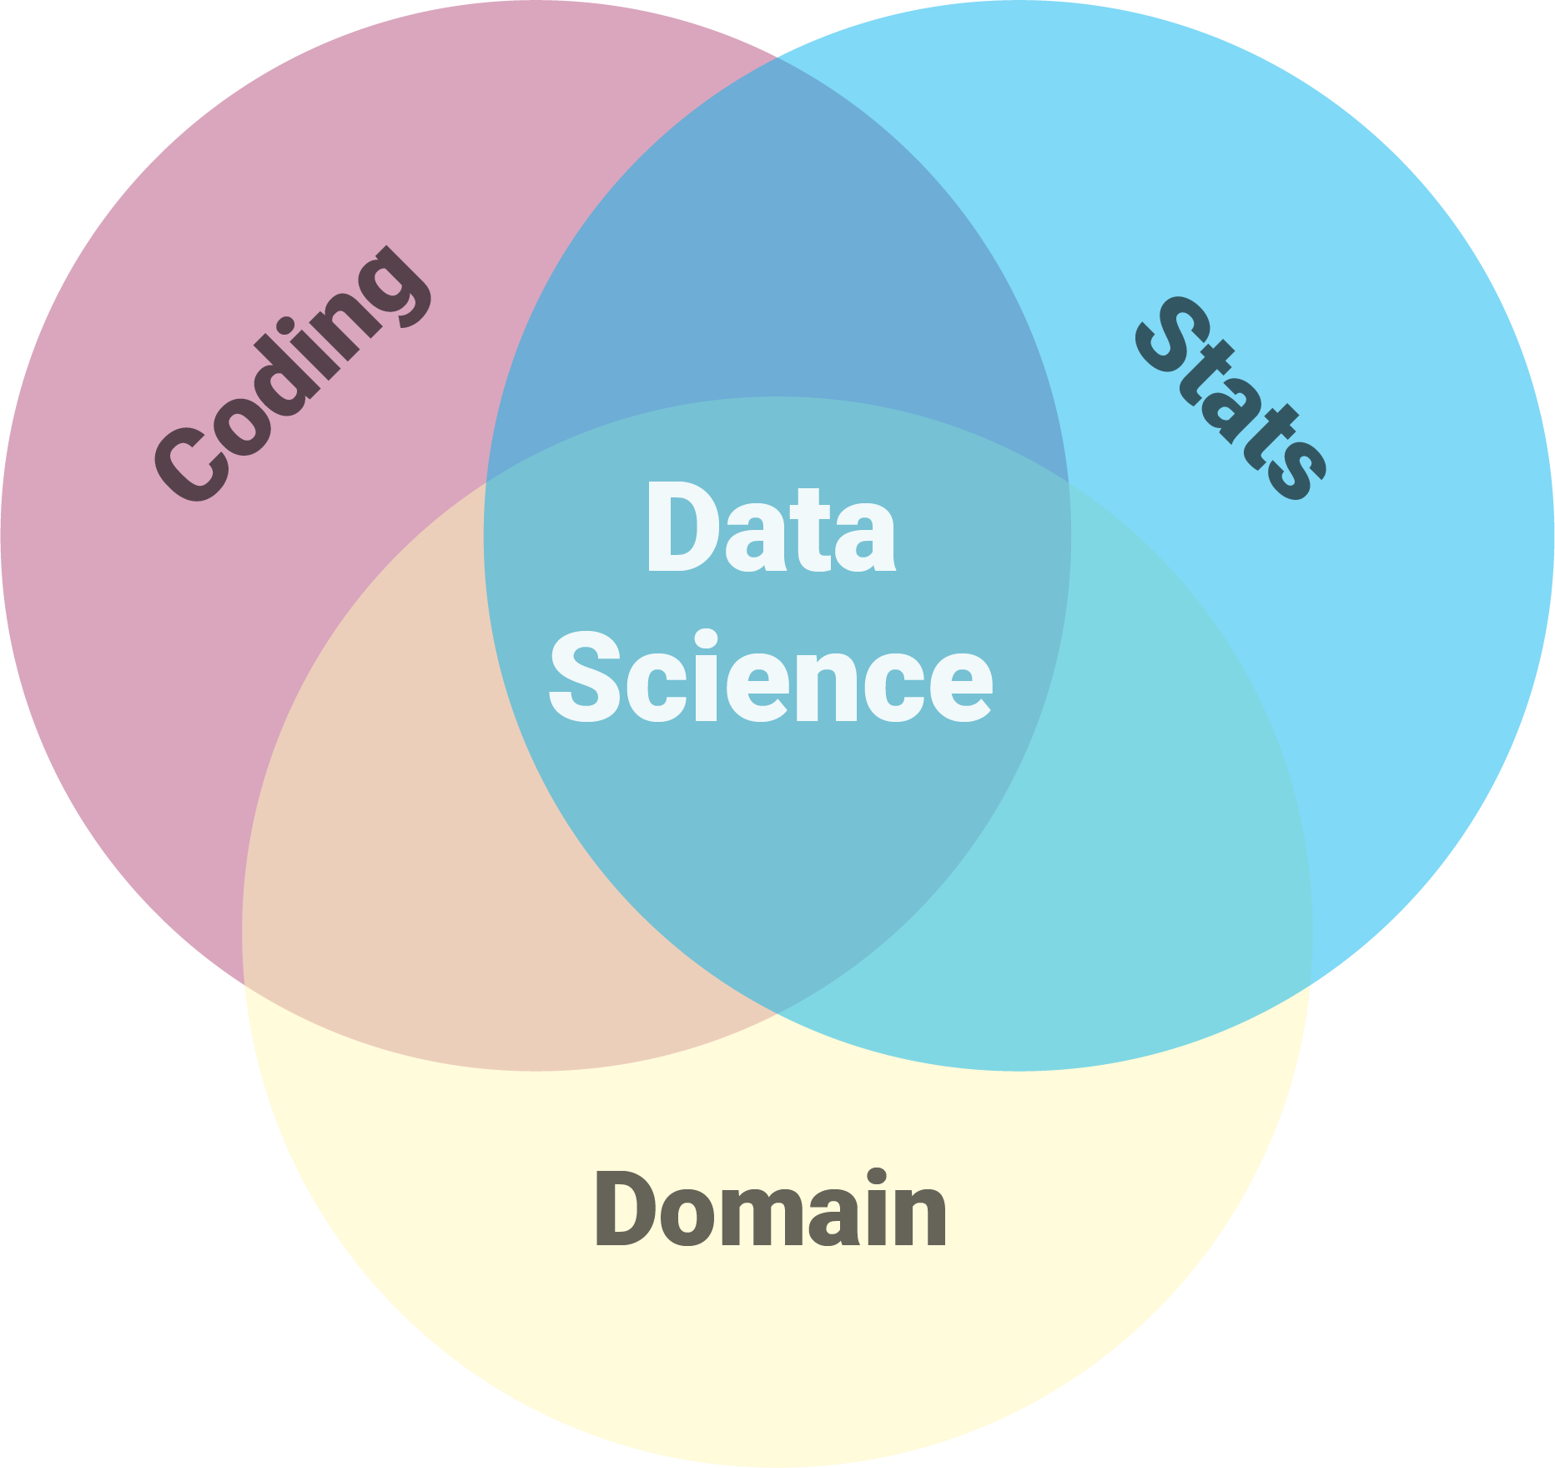

Slide 10
Solution

Slide 11
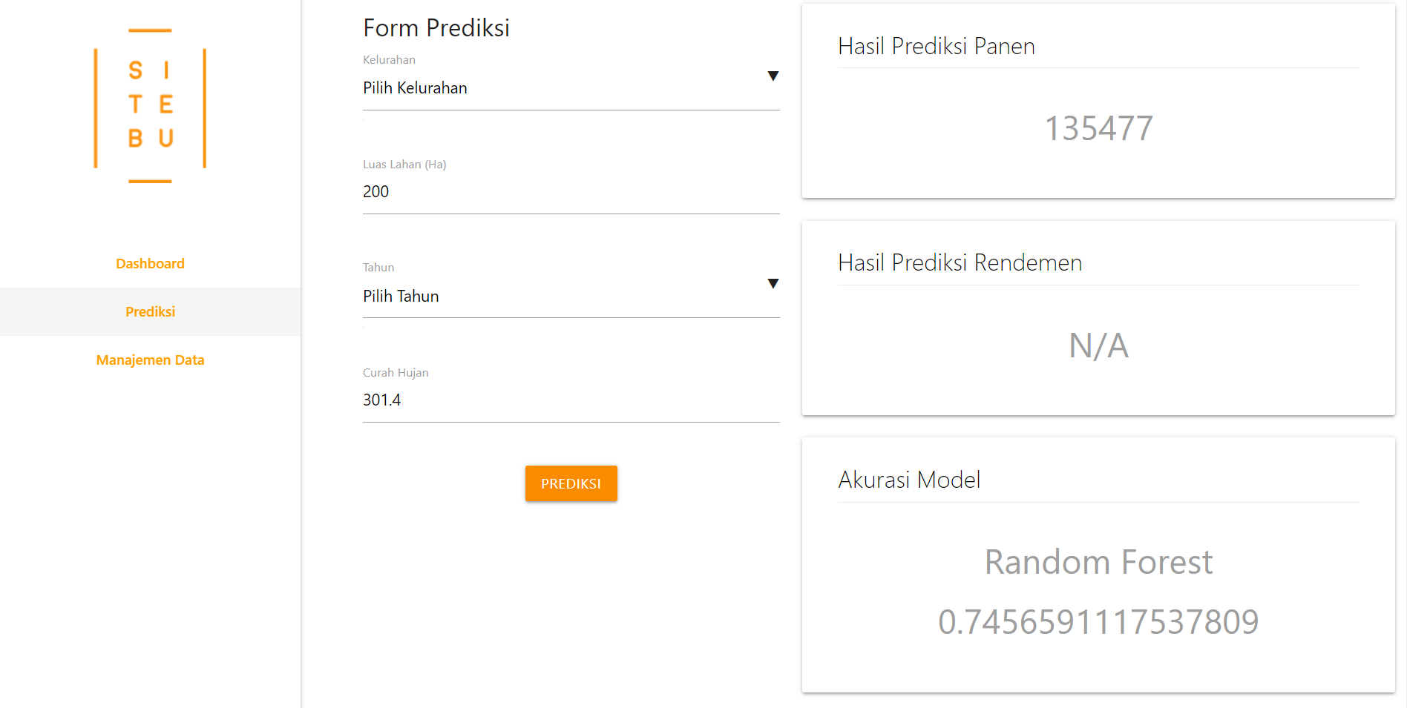
Solution

Slide 12
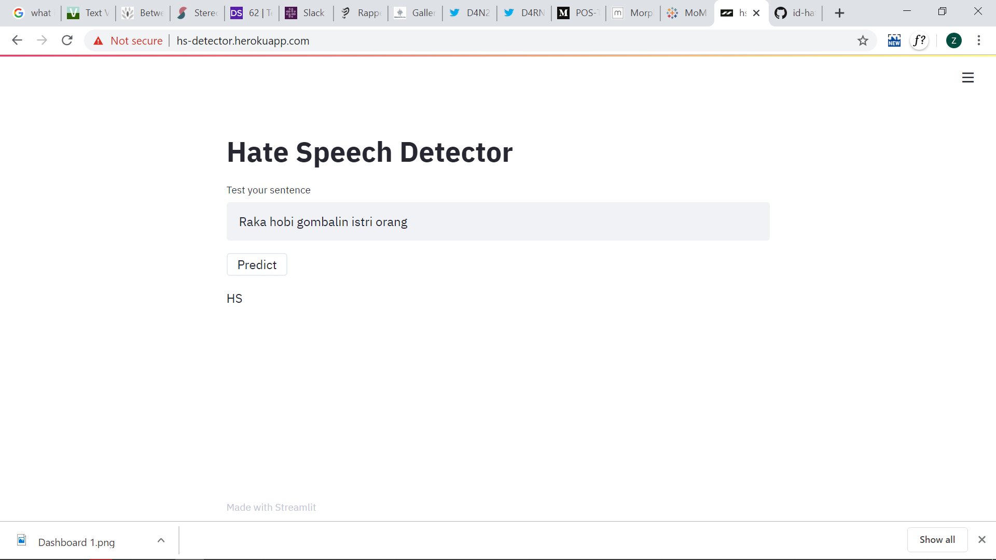

Solution

Slide 13
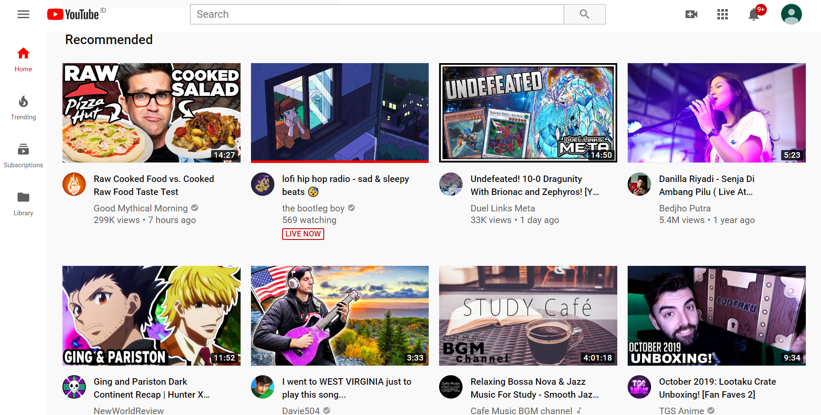
Solution

Slide 14
Awesome! How to make it tho?

Slide 15

We Need Data!

Slide 16
And Skills!

Slide 17
And Workflow!

Slide 18
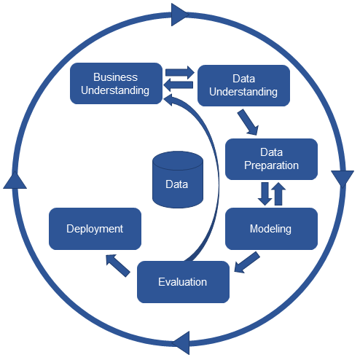
CRoss-Industry Standard Process for Data Mining

Slide 19
Let’s Start!

Slide 20
Data Gathering

Slide 21
Data Storage

Slide 22


Other Sources

Slide 23
Must Aligned with the Problems!

Slide 24
Data Exploration

Slide 25

Gain Insights
Statistical
Approach
Characteristics
of Data

Slide 26
Data Preprocessing

Slide 27

Outliers
Bunch of Methods
Clean Data
Null
Values
Hope the Machine Can Learn from it Effectively
Imbalance

Slide 28
Data Modelling

Slide 29
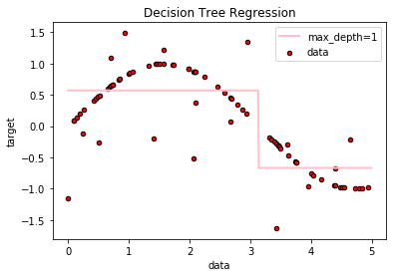
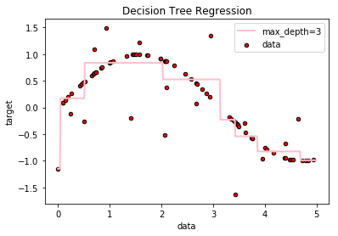
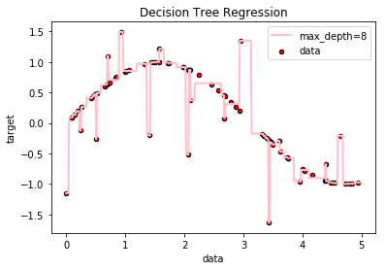
Create a Model That Fit ‘Nicely’ to the Data
Underfit
Good
Overfit

Slide 30
What Model?

Slide 31
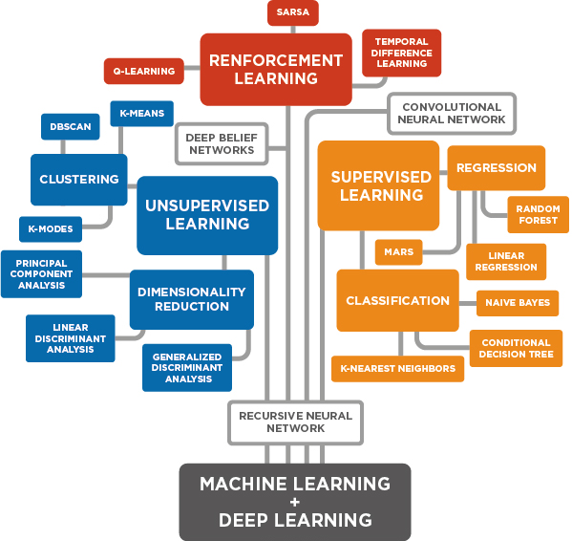

Slide 32
Model Validation

Slide 33
Dataset
Train Data
Test Data

Slide 34

Train Data
Test Data
Predict
Learning
Prediction
-
Actual Data
=
Error / Loss
Model Performance

Slide 35
Model Optimization

Slide 36
Increase model performance
Loss
Tuning

Slide 37
Model Deployment

Slide 38




Slide 39
Let’s Code!

Slide 40
Bonus Tips!

Slide 41
For learners
Do a lot of experiments
Copy other people's work (and try to understand it of course…)
Mastering data science workflow is a must
Learn exploratory data analysis
Learn maths (lol trust me on this)

Slide 42
That’s all folks!

Slide 43
Always Share Your Knowledge!

Slide 44

Contact Me
Instagram : zakysyihan
Email : ahmadzakysyihan@gmail.com
LinkedIn : Zaky Syihan
Medium : Zaky Syihan

